Slide 1
Expeditor
Urban Food-Supply Marketplace and Delivery Optimization System
IFT 402 Paul Polsinelli

Slide 2
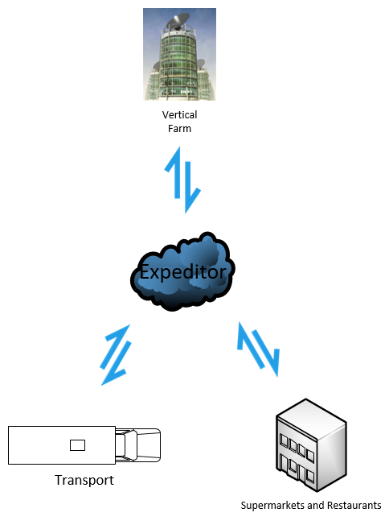
Fresh food, produced by indoor vertical farms, delivered to local markets with next to zero food waste, at minimal cost, with maximum fuel savings.
Expeditor

Slide 3

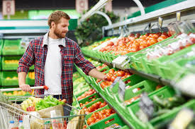
The Urban Stakeholders: Supermarkets, Restaurants, and their Customers

Slide 4
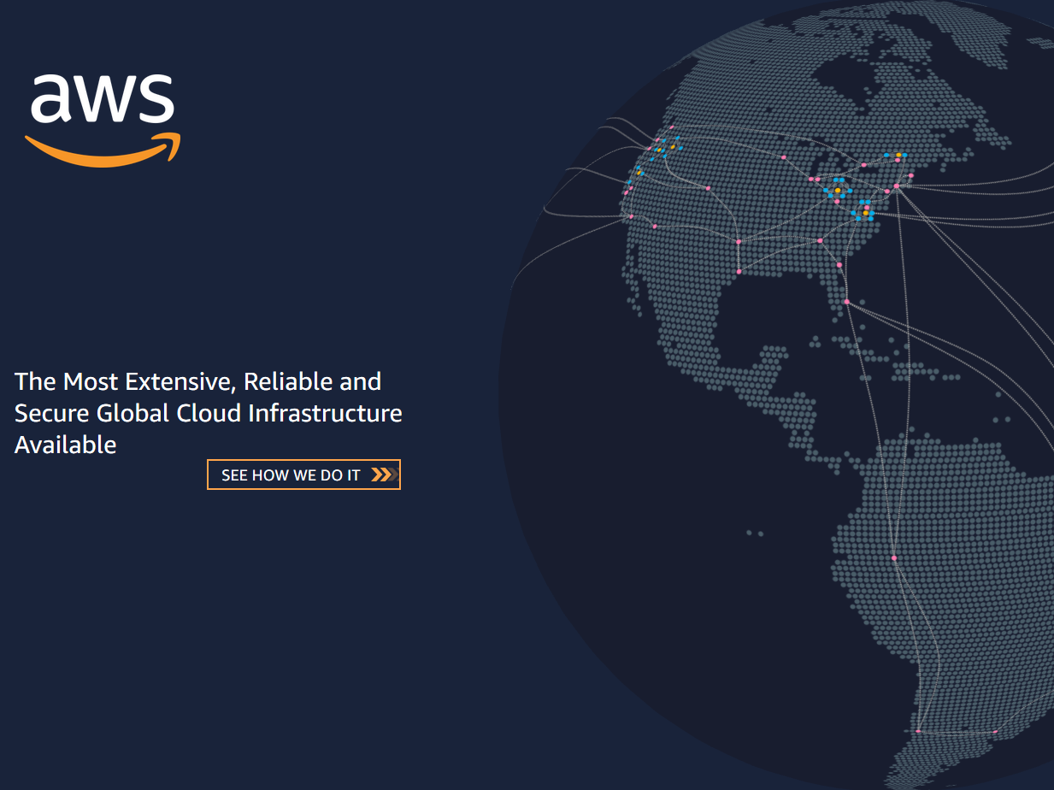









The Technology
Tensorflow
Keras
<html>
API REST framework
<CSS>
<javascript>

Slide 5
The Build
The final build has added 4 supermarkets and 4 restaurants
The new customers have been added to the excel distance matrix
The Expeditor script has had an extensive redesign, adding iteration of csv files for customer orders, dynamic variable creation from filenames, variable inputs to mysql queries using f-strings, matching files to table columns using dynamic variables for appending, order forecast extended to 8 weeks for production readiness, new order data written automatically to csv files to build model database, and UI table data dynamically written.
The email confirmation has been updated to include more order information
Django script has been updated to include a new table and several attributes added to an existing table for greater functionality.

Slide 6
Accomplishments
Dynamic variables created directly from csv filenames for customer data matching, appending, and creation of derivative variables
Distance Matrix updated with 8 new customers
Expeditor script now iterates though customer csv files directly and has unlimited scalability without further coding though csv file addition
1 Database table added for UI table display
UI dynamically populates all data for product, quantity, deliver date, total price and more
Custom API added for additional table
Email enhanced with more order data
Order prediction extended to 8 weeks in future for production readiness and timely delivery
Script dynamically writes all new order data to customer csv files to build AI prediction database

Slide 7

Progress

Slide 8
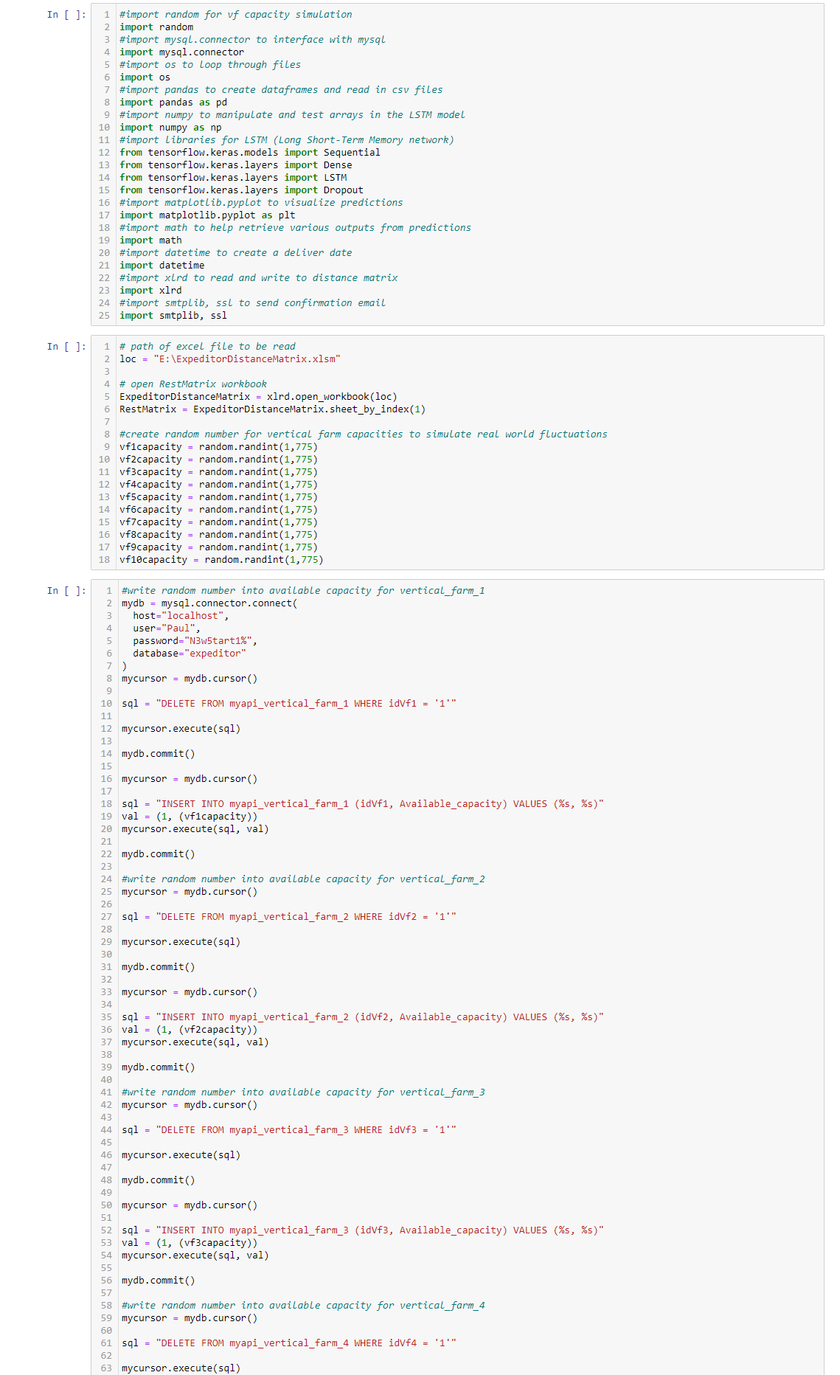
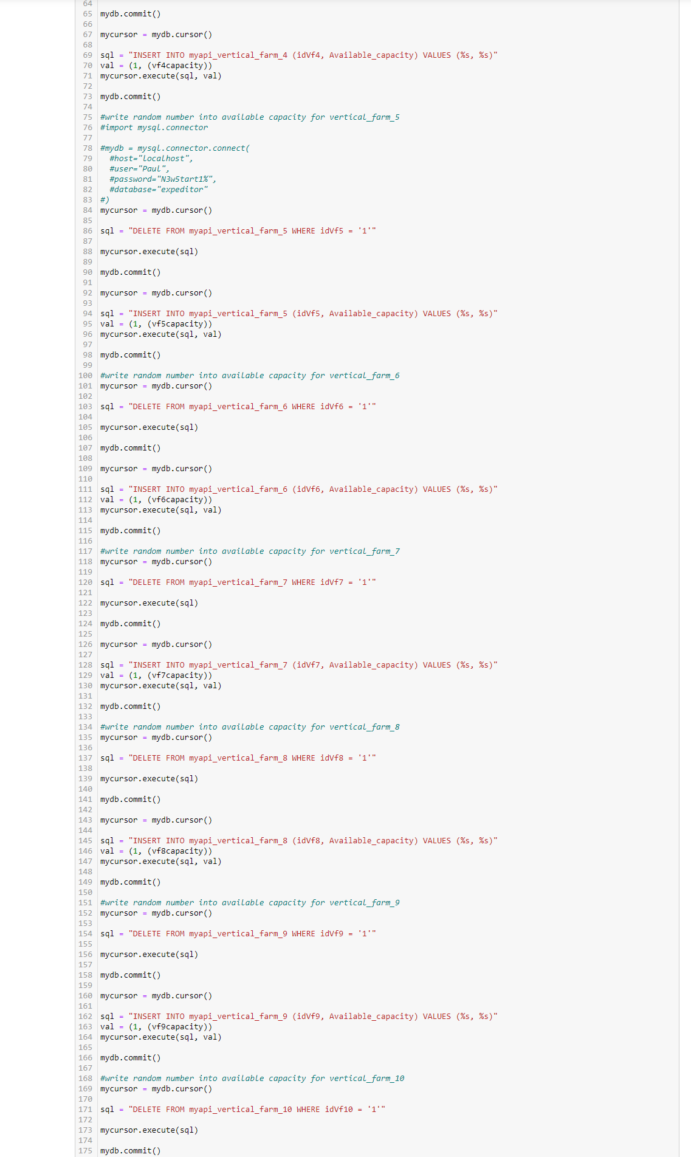
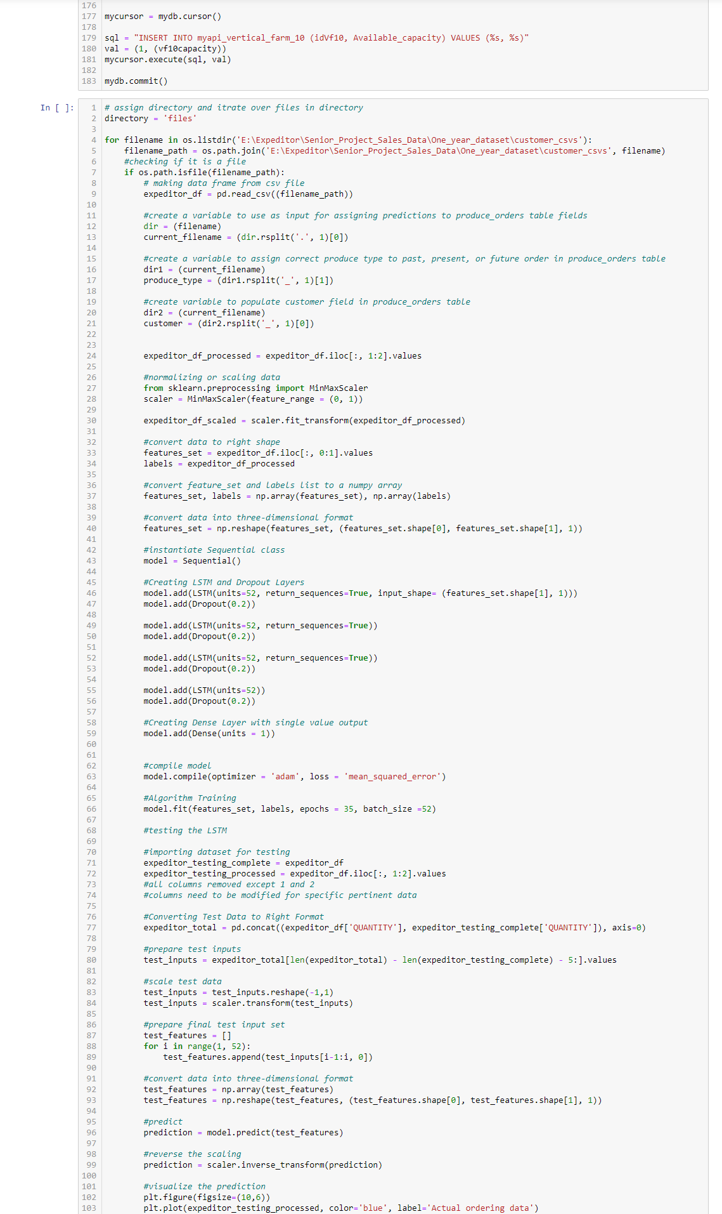
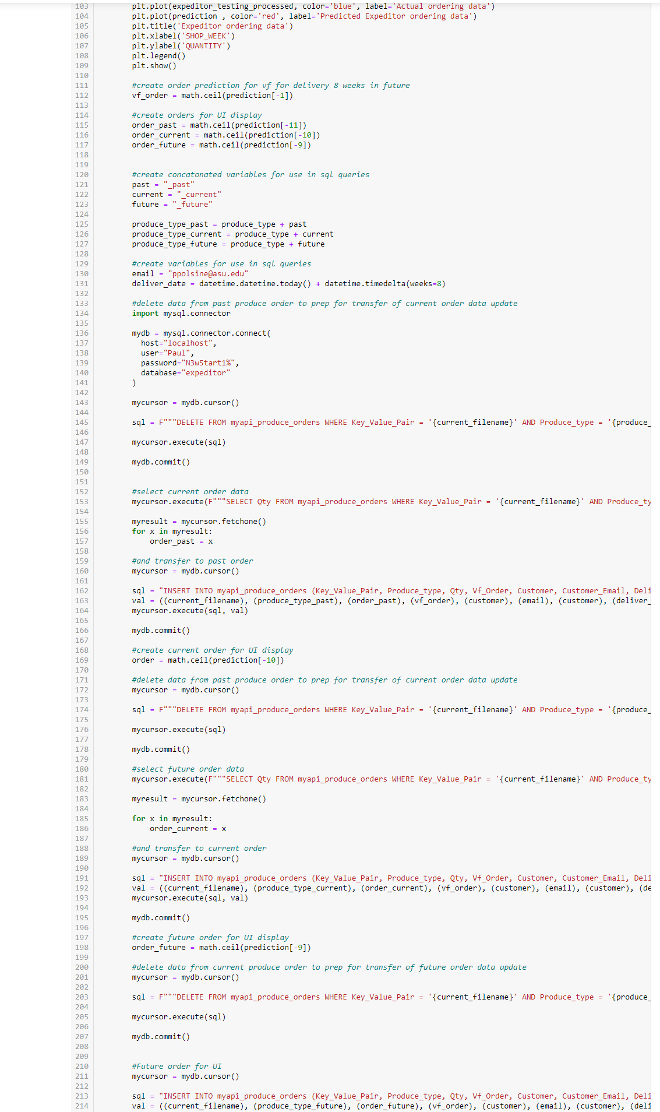
Step 1: The AI Expeditor Script
Written in Tensorflow environment in Python language with the Tensorflow and Keras libraries. Displayed in Jupyter Notebook. Uses a Long Short-Term Memory (LSTM) predictive recurrent neural network.
The script reads in an adapted 52-week sales data dunnhumby “Let’s Get Sort-of-Real” dummy supermarket sales dataset. https://www.dunnhumby.com/source-files/
For three products (Romaine, Kale, and Basil), the script interfaces with mysql, predicts a sales order quantity, writes it to the ‘future order’ rows, rewrites previous future order to ‘current order’ rows, and rewrites current order to ‘past order’ rows.

Slide 9
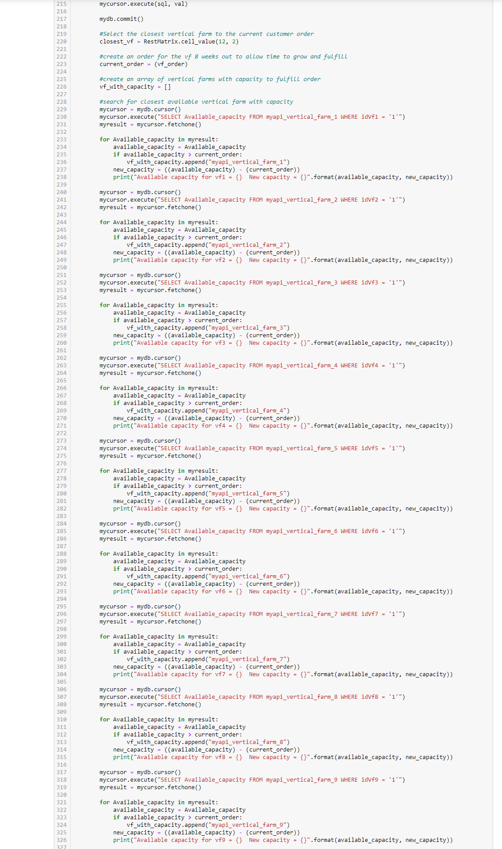
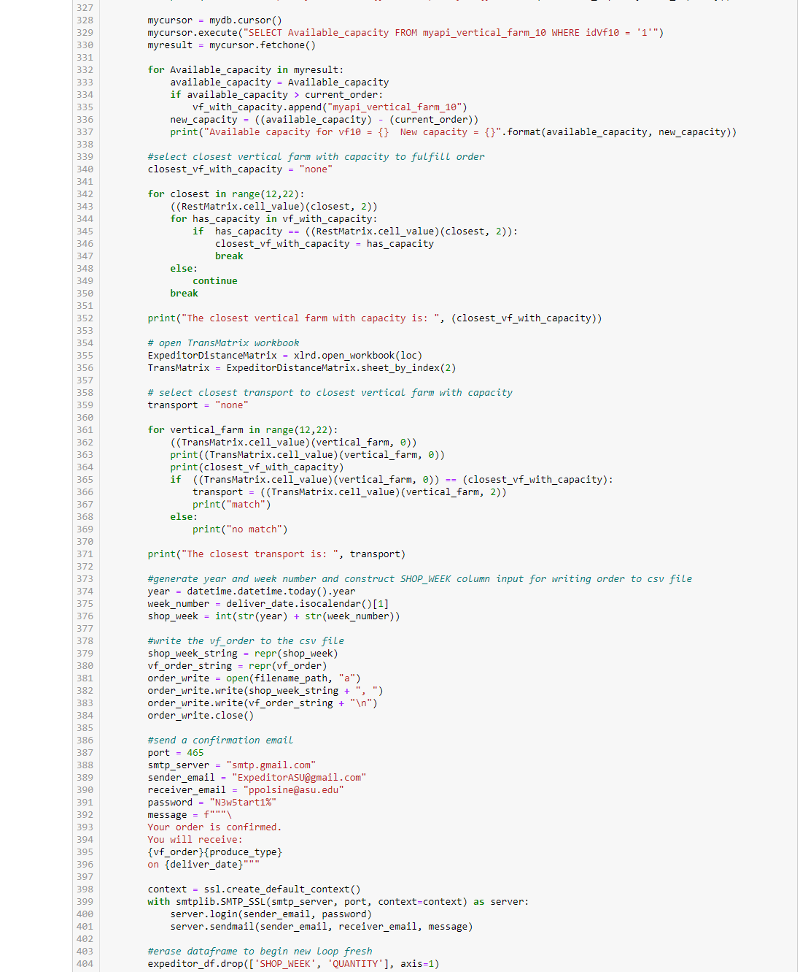
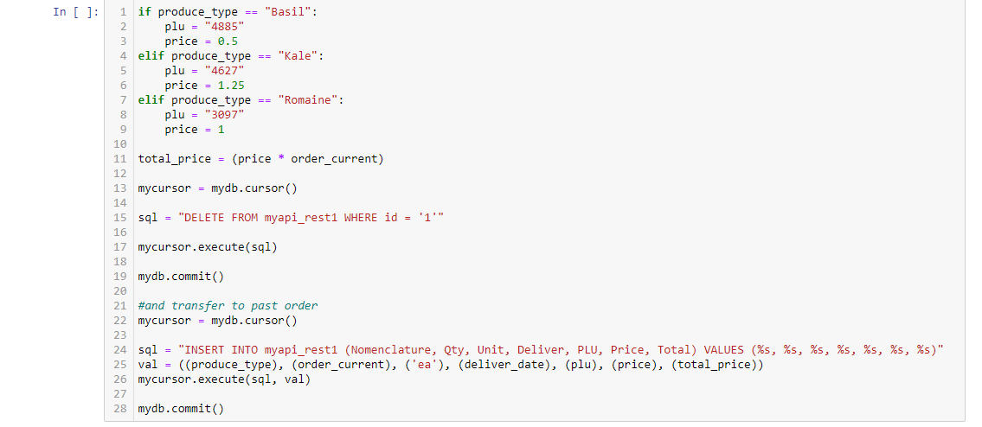
Step 1 continued: The AI Expeditor Script

Slide 10
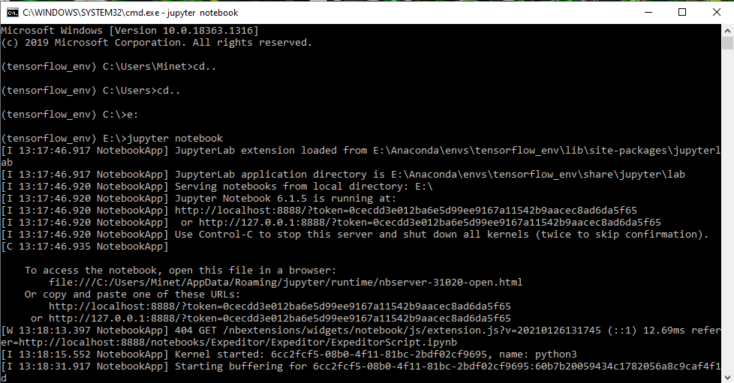
Tensorflow environment Jupyter Notebook cmd interface

Slide 11
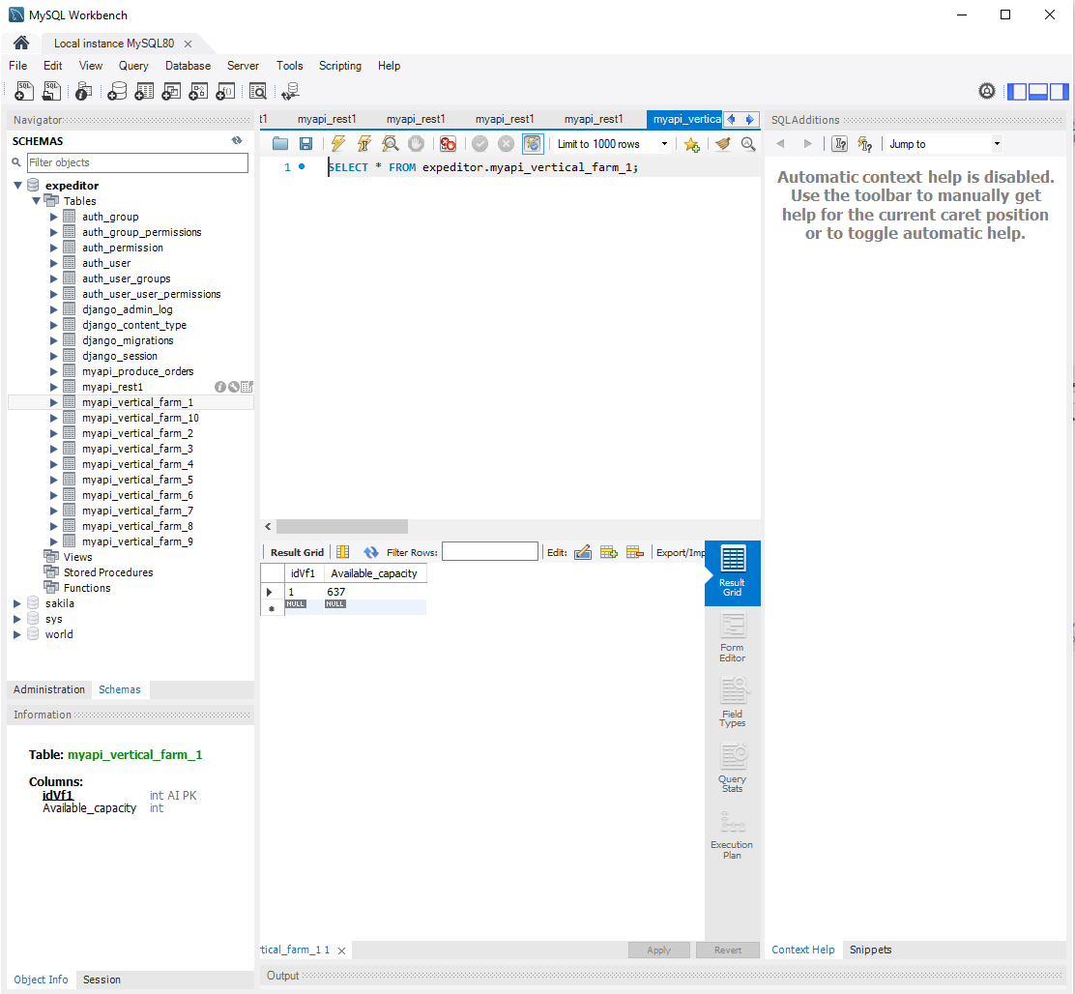
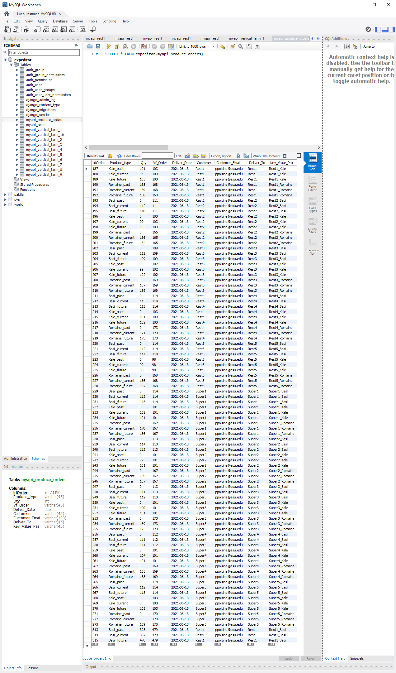
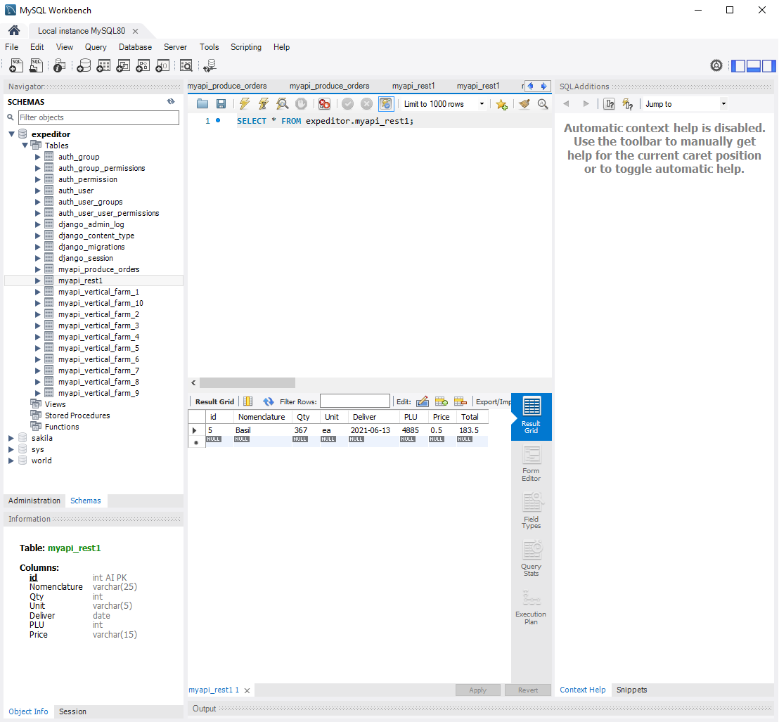
Step 2: The Expeditor Database
Interfaces with the Expeditor Script for predictive input and Django REST Framework for API transactions. Will contain more tables for Vertical Farm data and Transport data in coming builds.

Slide 12
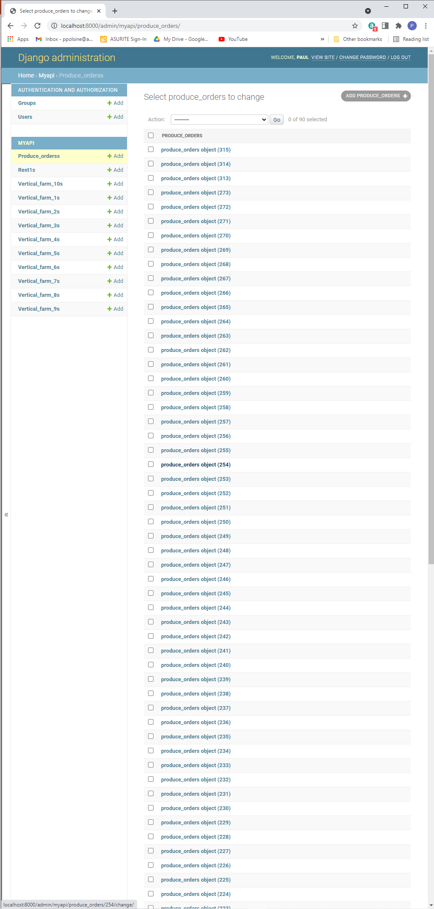
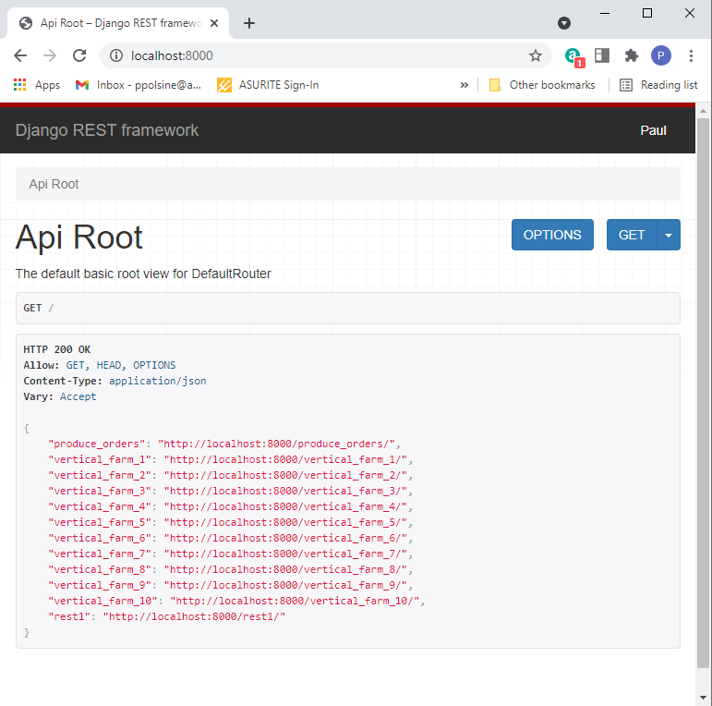
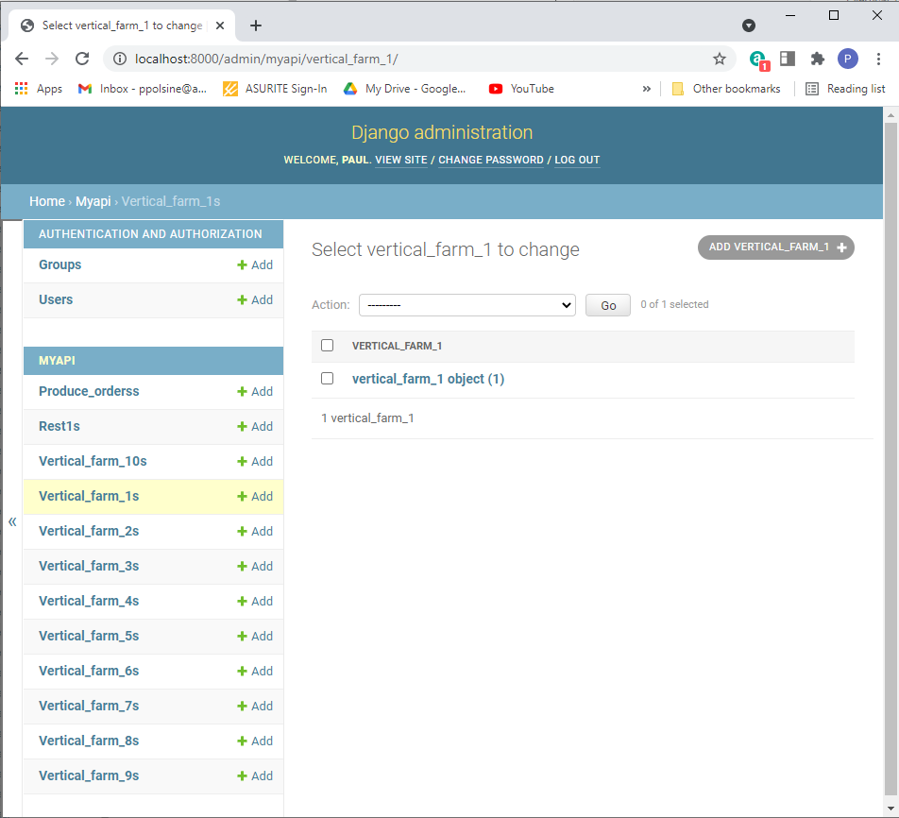
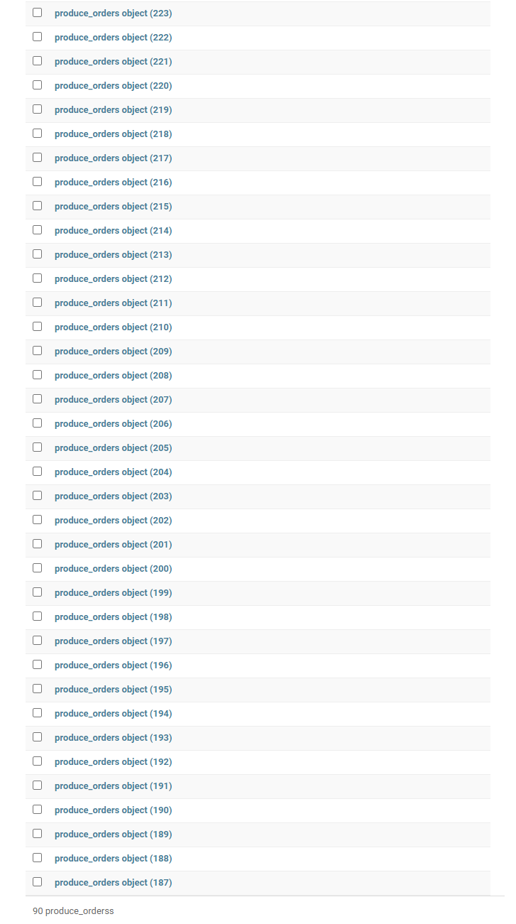
Step 3: Django Rest Framework
Interfaces with the Expeditor Database. It incorporates the Expeditor Supermarket and Restaurant User Interface within its framework and interacts with the HTML, CSS, and JS code through specialized coding interfaces.

Slide 13
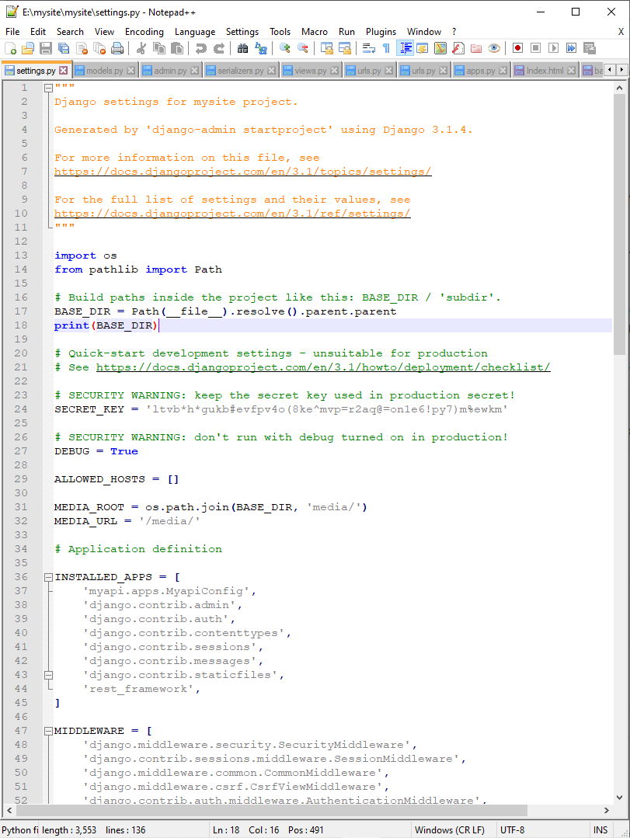
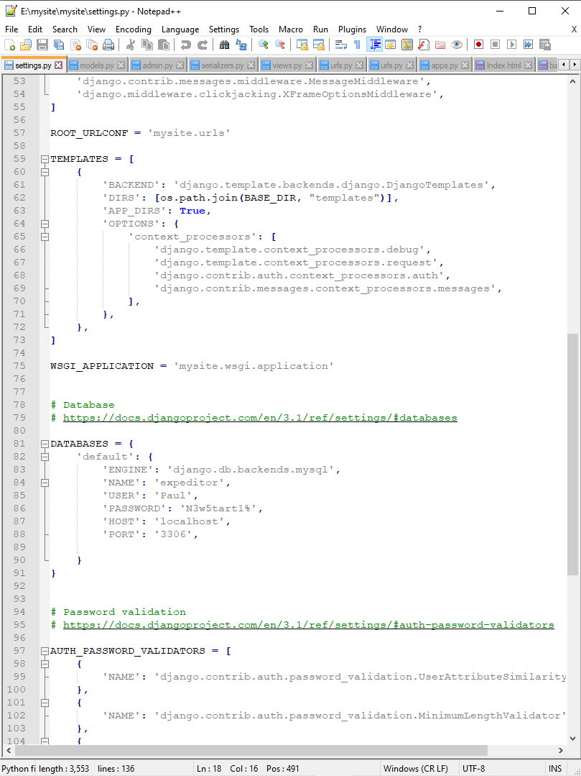
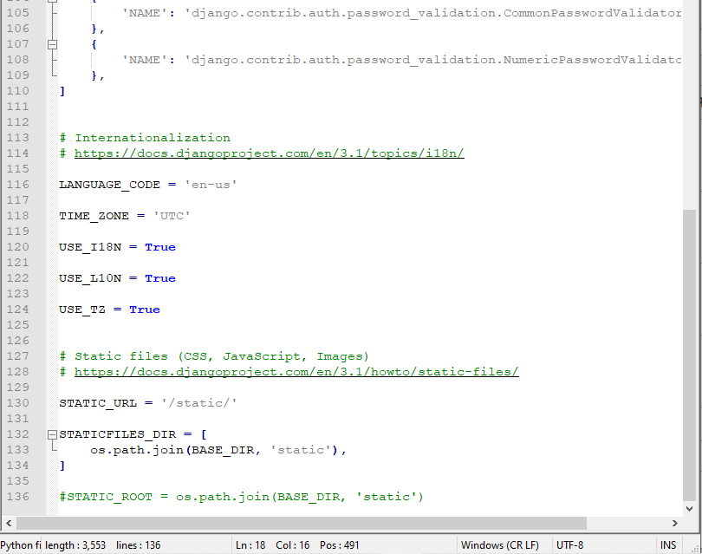
Step 3 continued: settings.py
Django settings.py file is the main file that creates the app that interfaces with the database, defines the database, connects to HTML templates, CSS, JS, and media files.

Slide 14
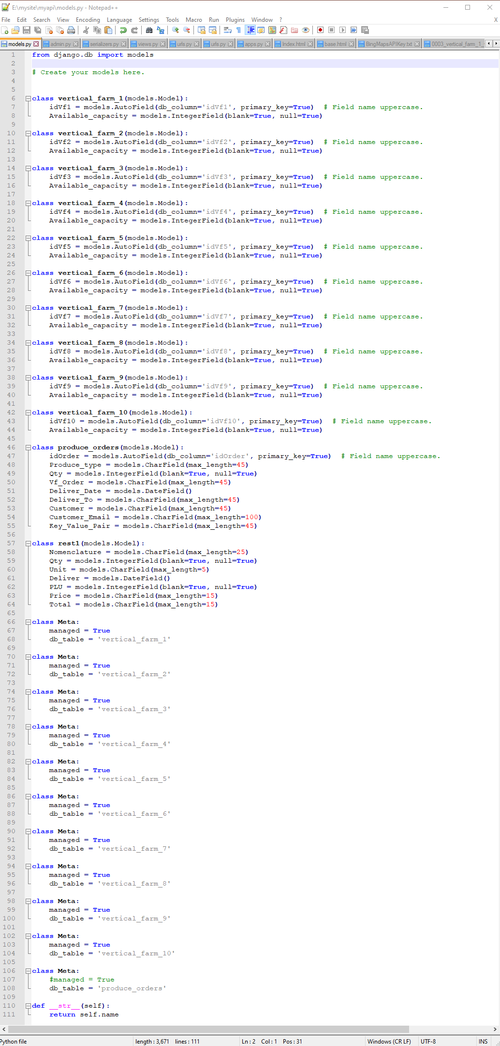
Step 3 continued: models.py
Django models.py file defines the db tables from the settings.py defined db within the Django REST Framework.

Slide 15
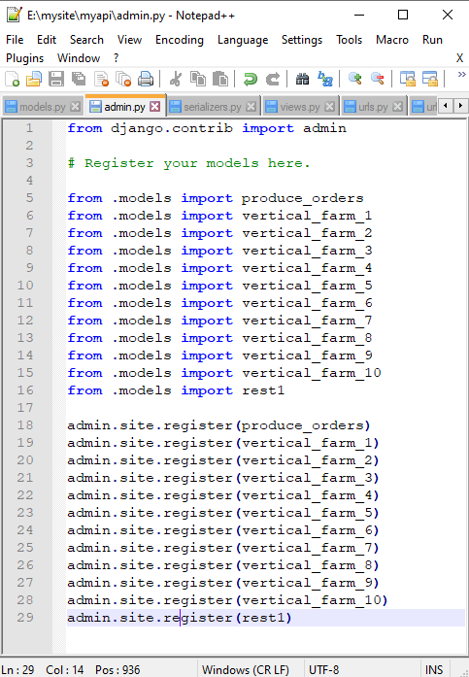
Step 3 continued: admin.py
Django admin.py registers the tables from models.py with Django administration so they may be acted upon within the framework.

Slide 16
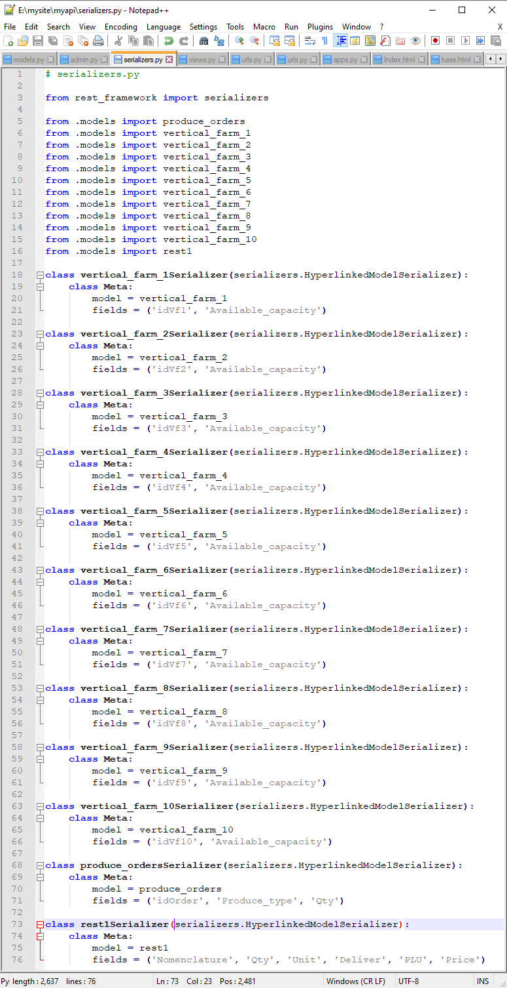
Step 3 continued: serializers.py
Django serializers.py connects and transforms the data in the tables into encapsulated json files.

Slide 17
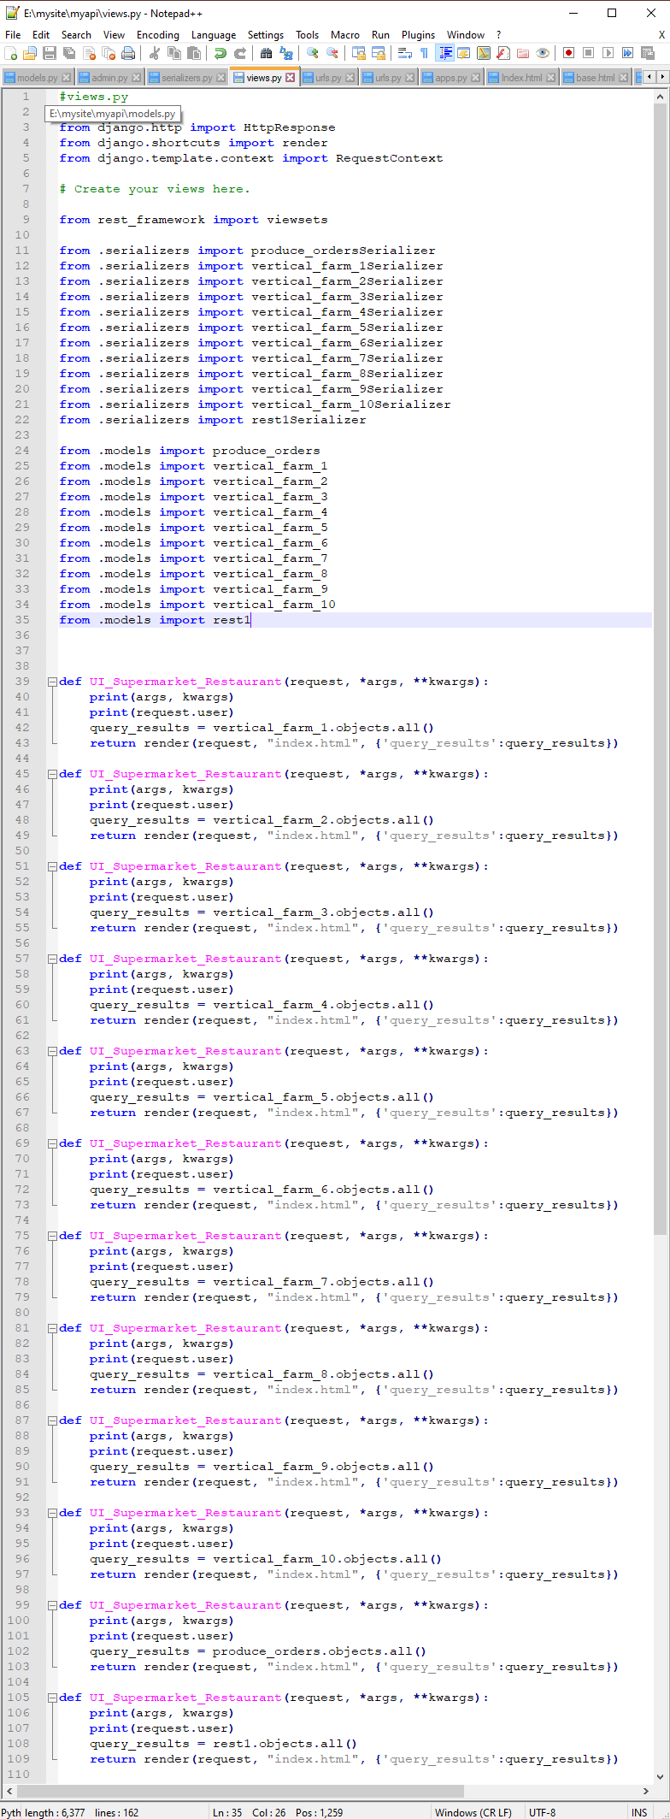
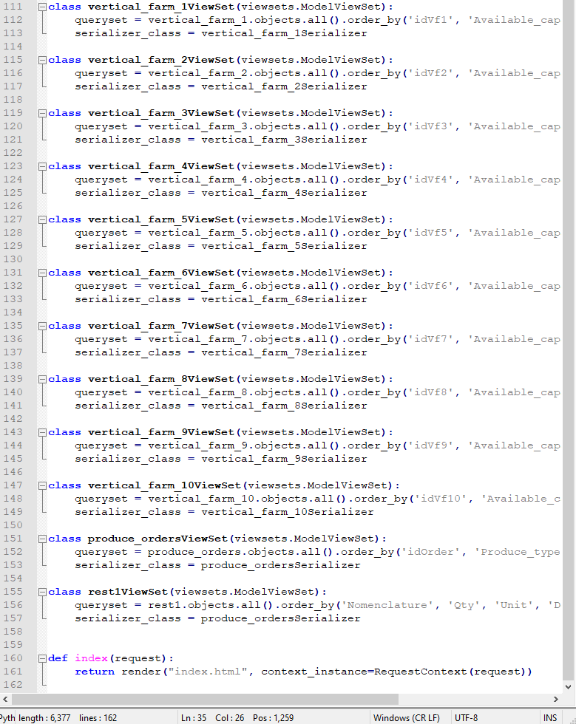
Step 3 continued: views.py
Djano views.py creates the functions that render the json data files into the UI tables.

Slide 18
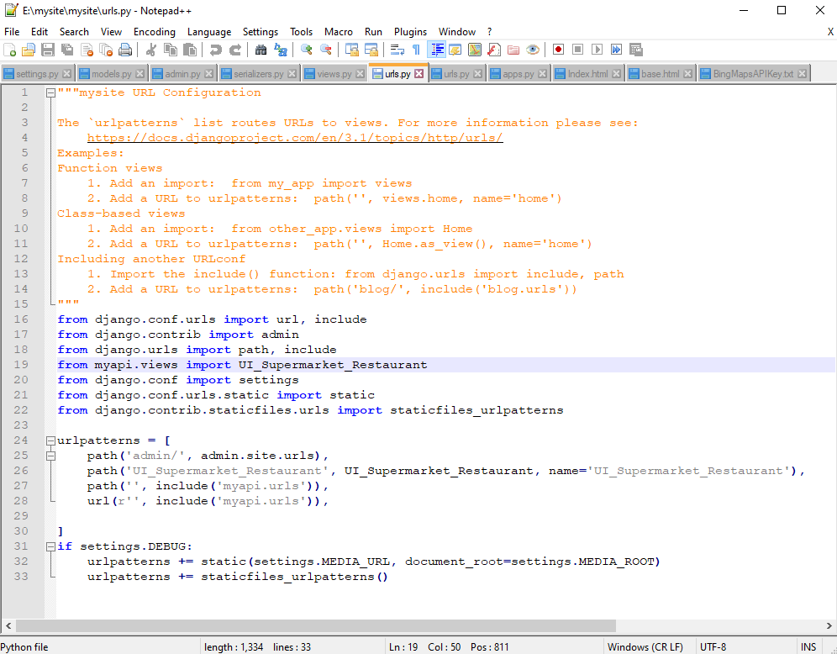
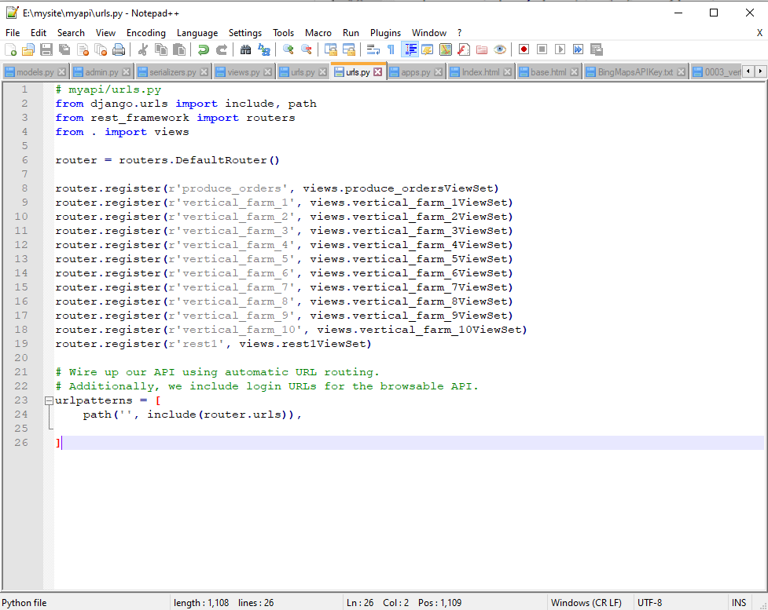
Step 3 continued: urls.py
There are two urls.py in Django REST framework that concern themselves with routing the data between the DB and the UI.

Slide 19
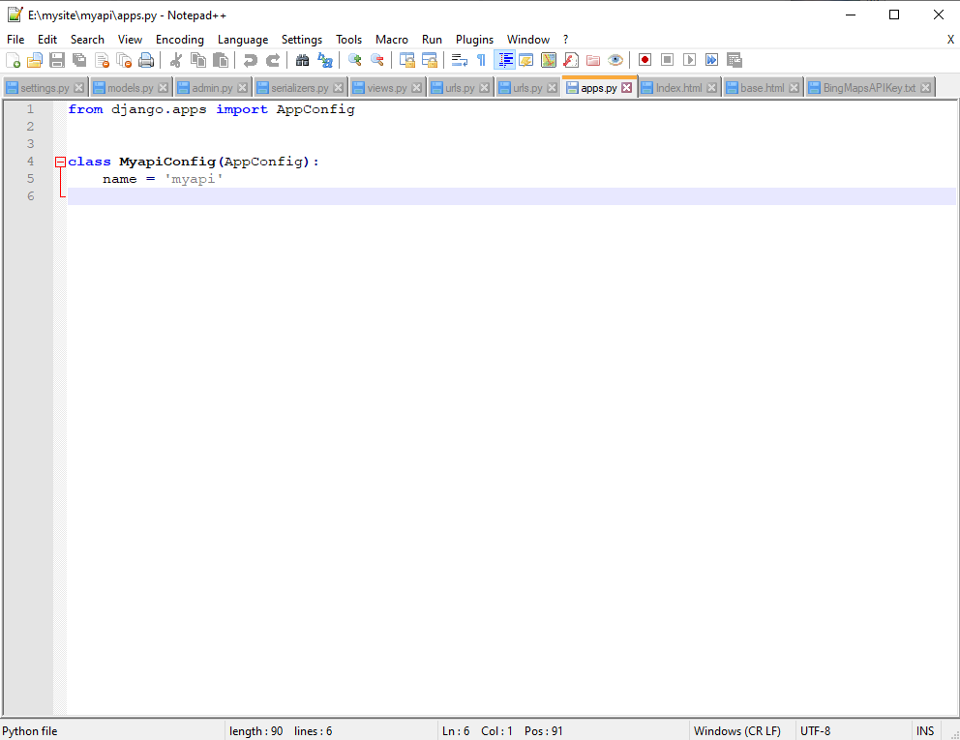
Step 3 continued: apps.py
Django apps.py holds the information about the apps created by settings.py.

Slide 20
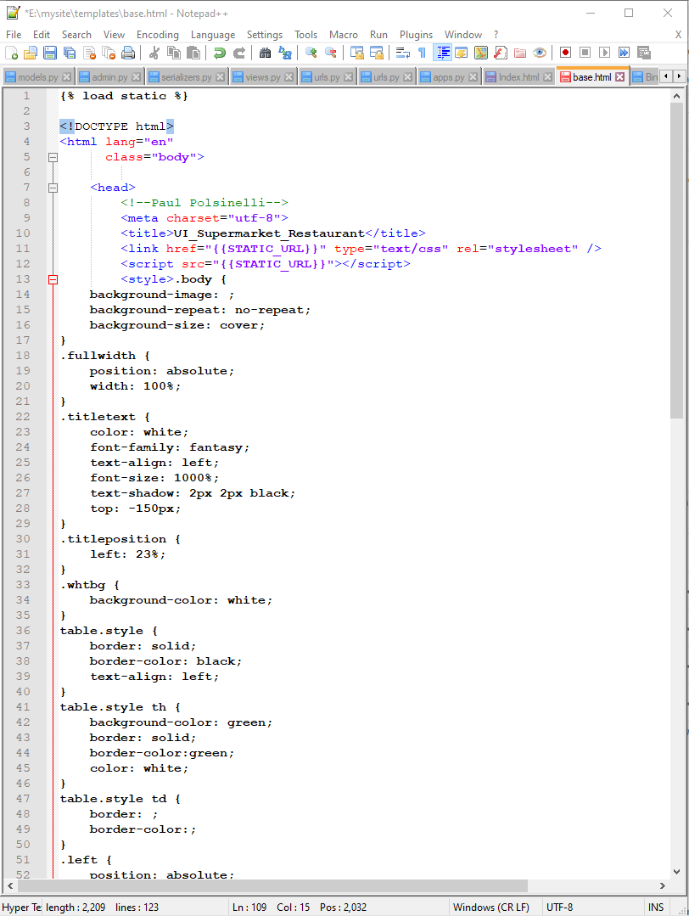
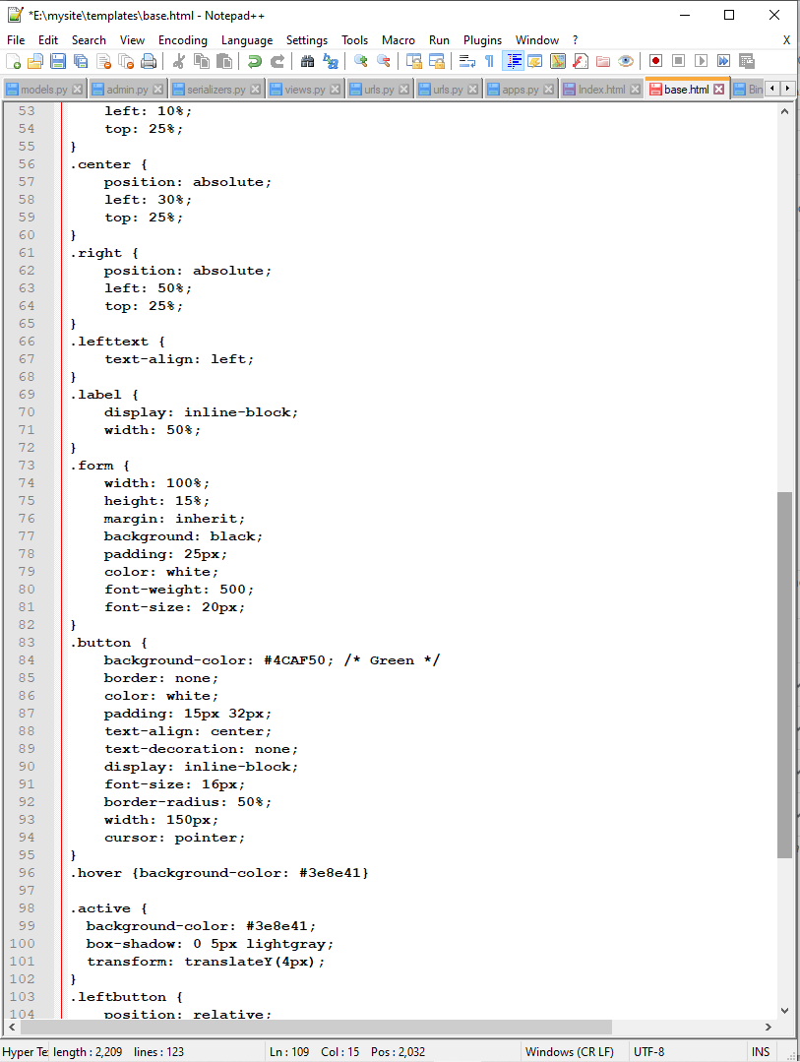
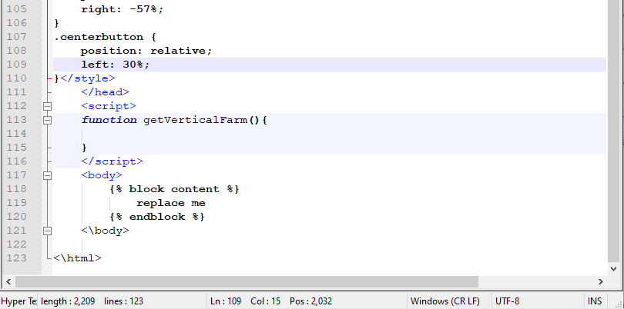
Step 3 continued: base.html
The main HTML file within the Django framework that holds the metadata and contains the connective code to the body and static files.

Slide 21
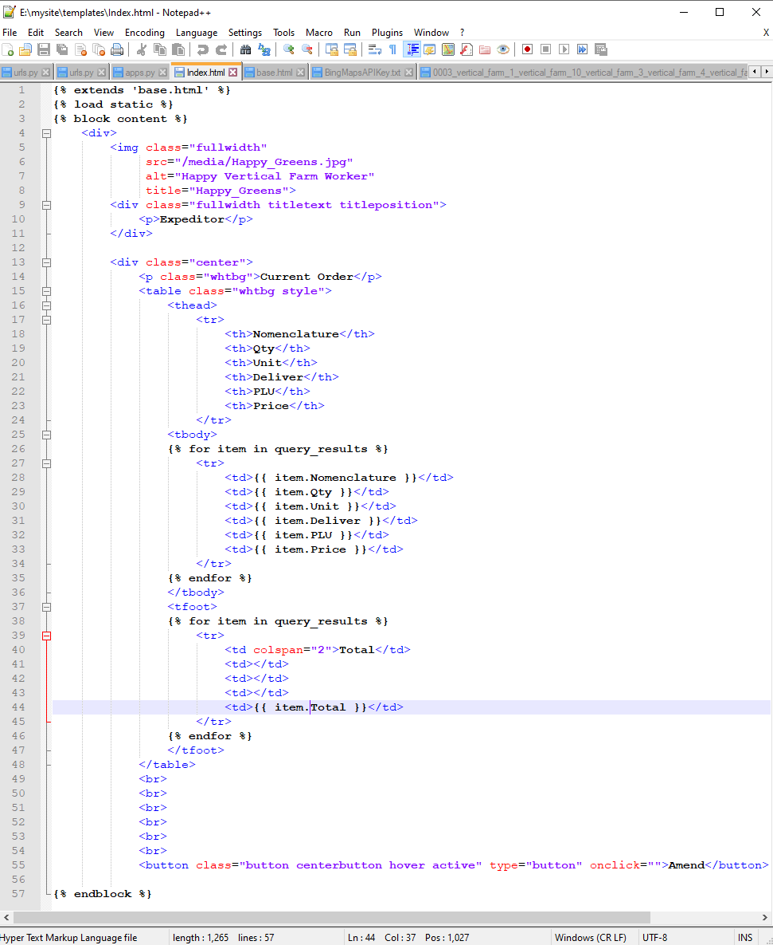
Step 3 continued: Index.html
The Django file that holds the body of the html code and connects to base.html.

Slide 22
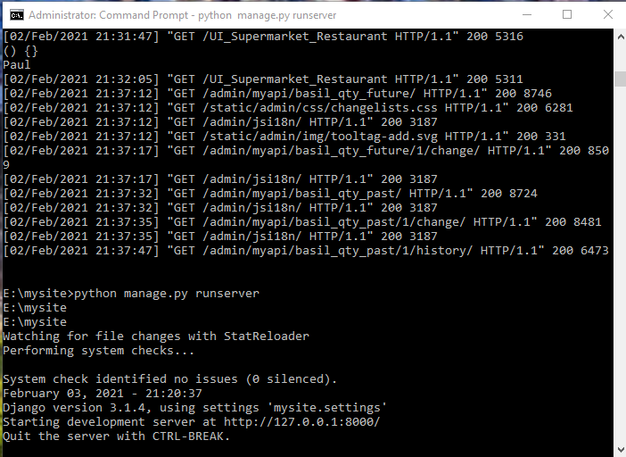
Django server cmd interface

Slide 23
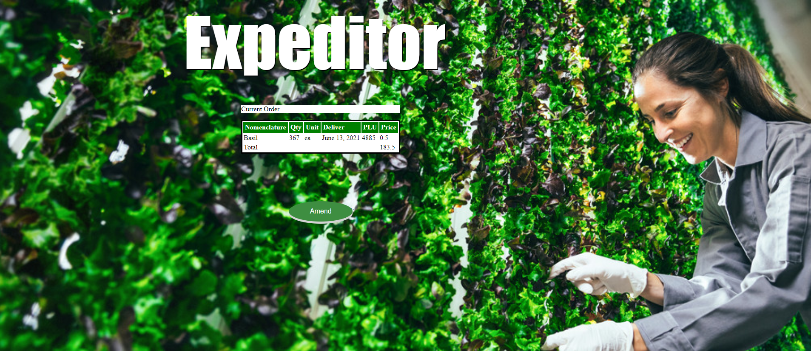
Step 4: Supermarket and Resturant UI

Slide 24
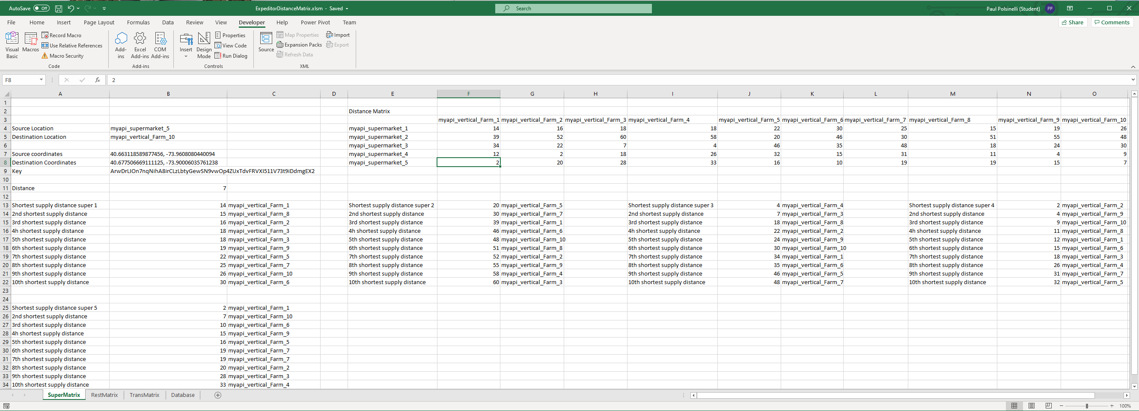
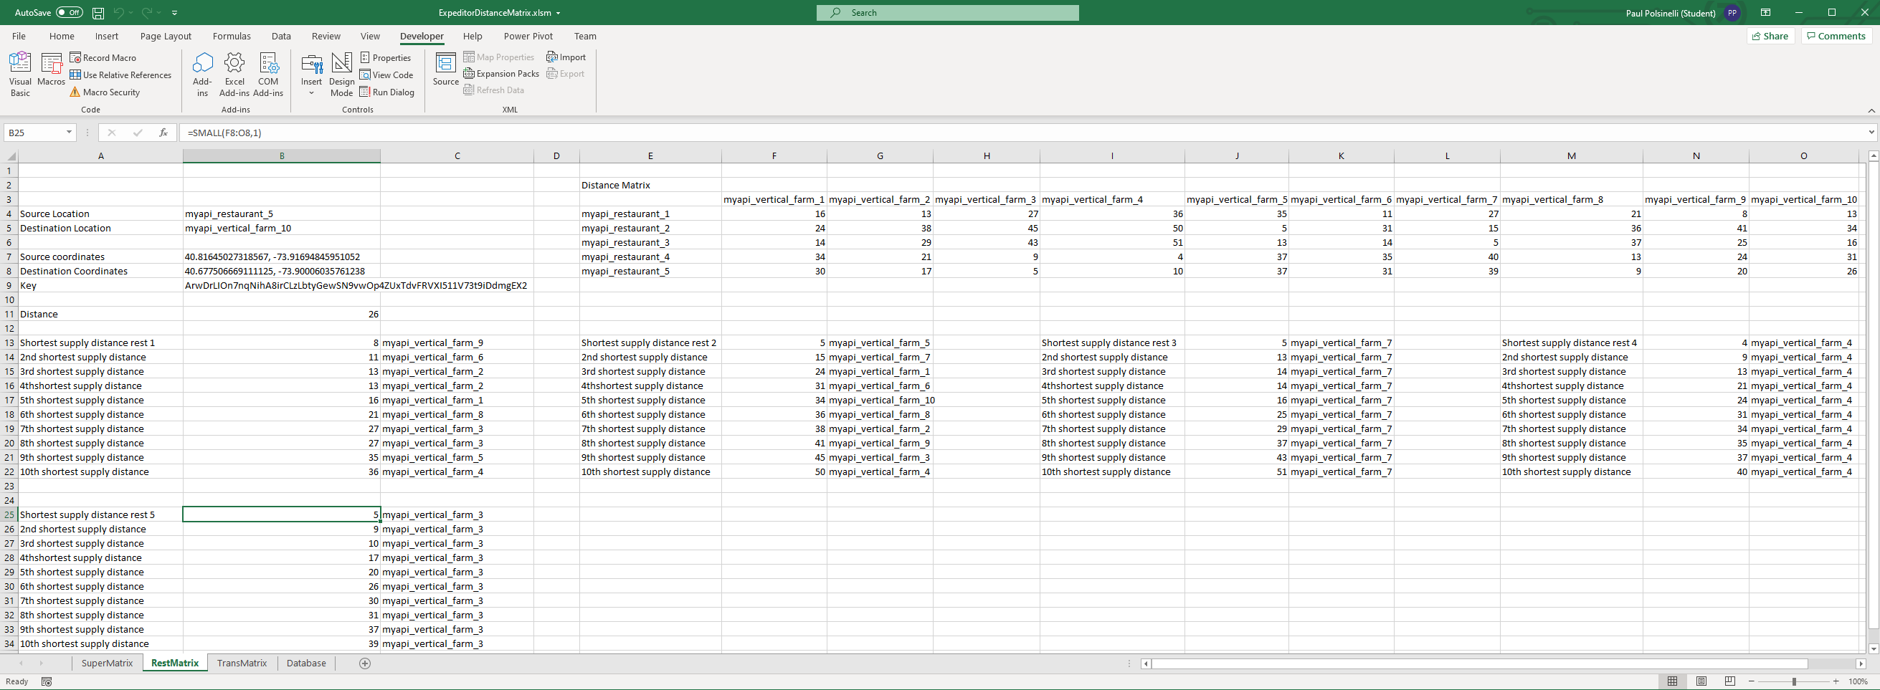
Step 5: Distance Matrix
Calculates the distances between the producers and suppliers

Slide 25
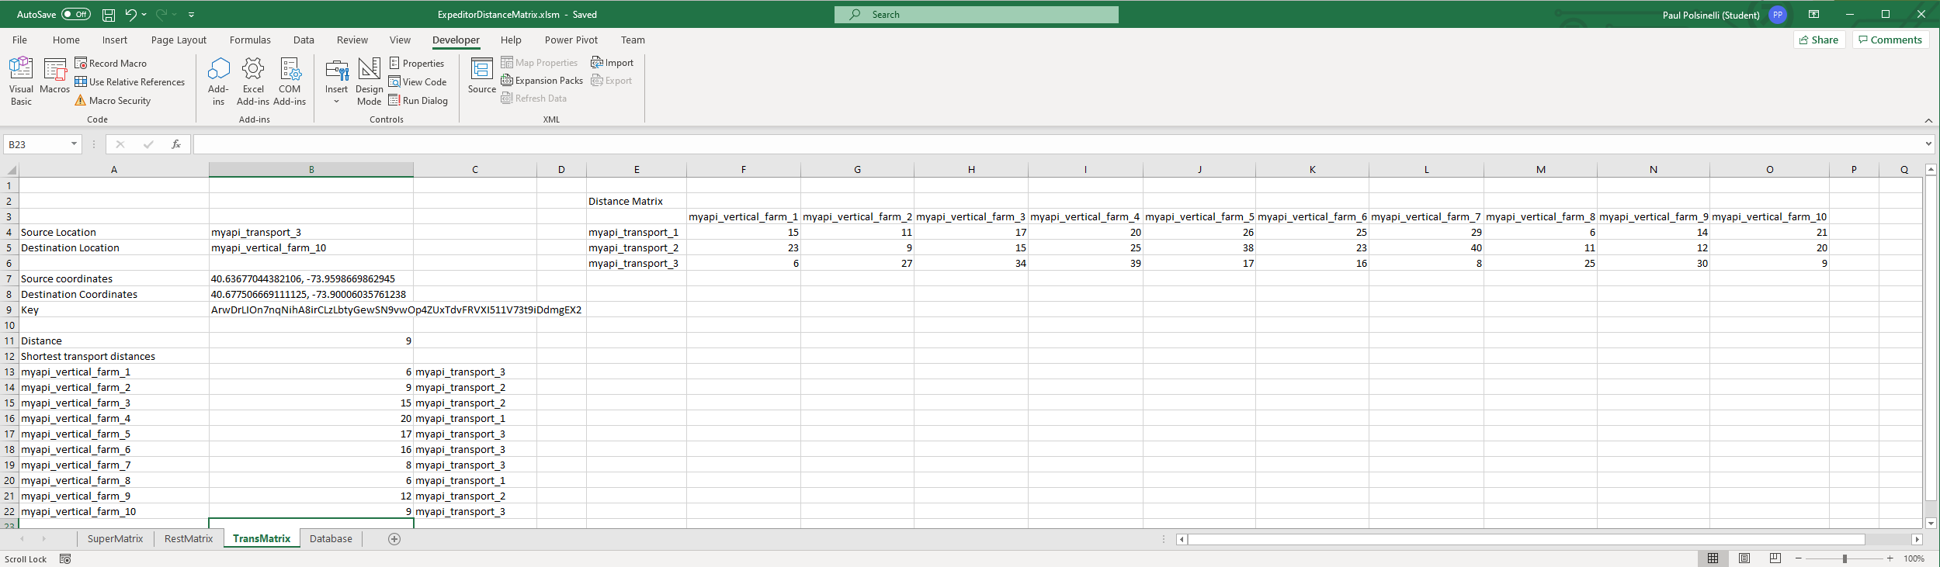
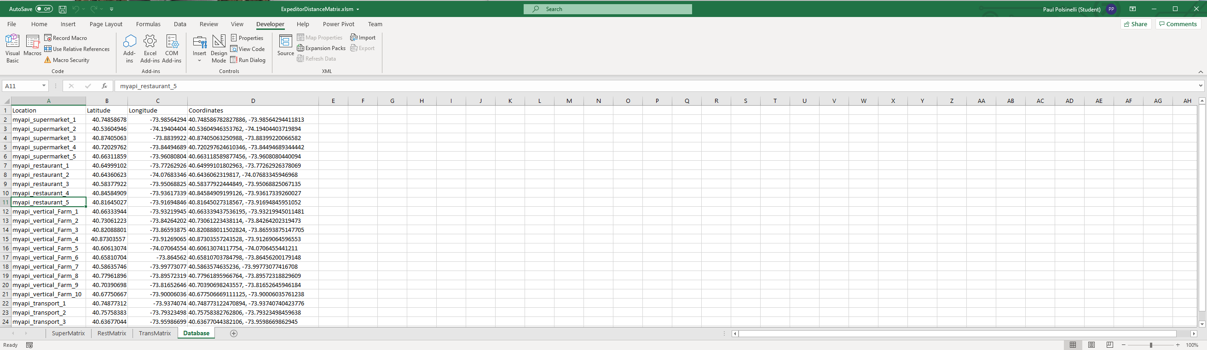
Step 5 continued: Distance Matrix

Slide 26
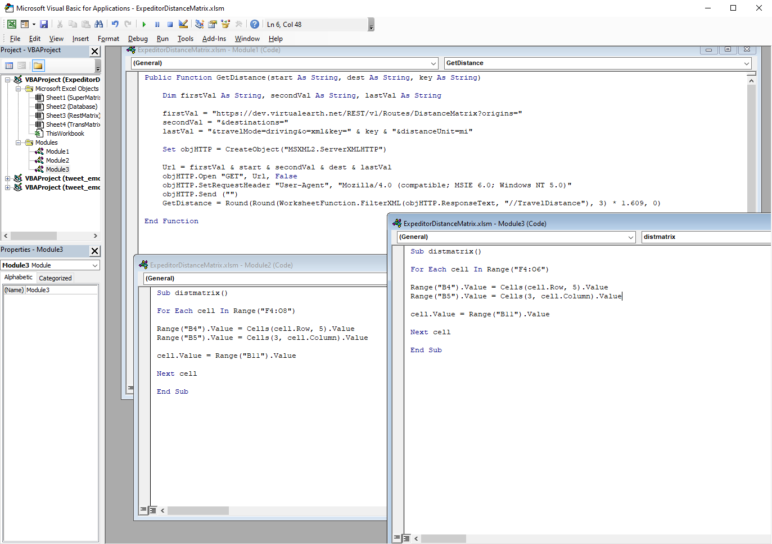
Visual Basic for Applications code for distance matrix
Code to utilize the Bing Maps API and to populate the distance matrices

Slide 27
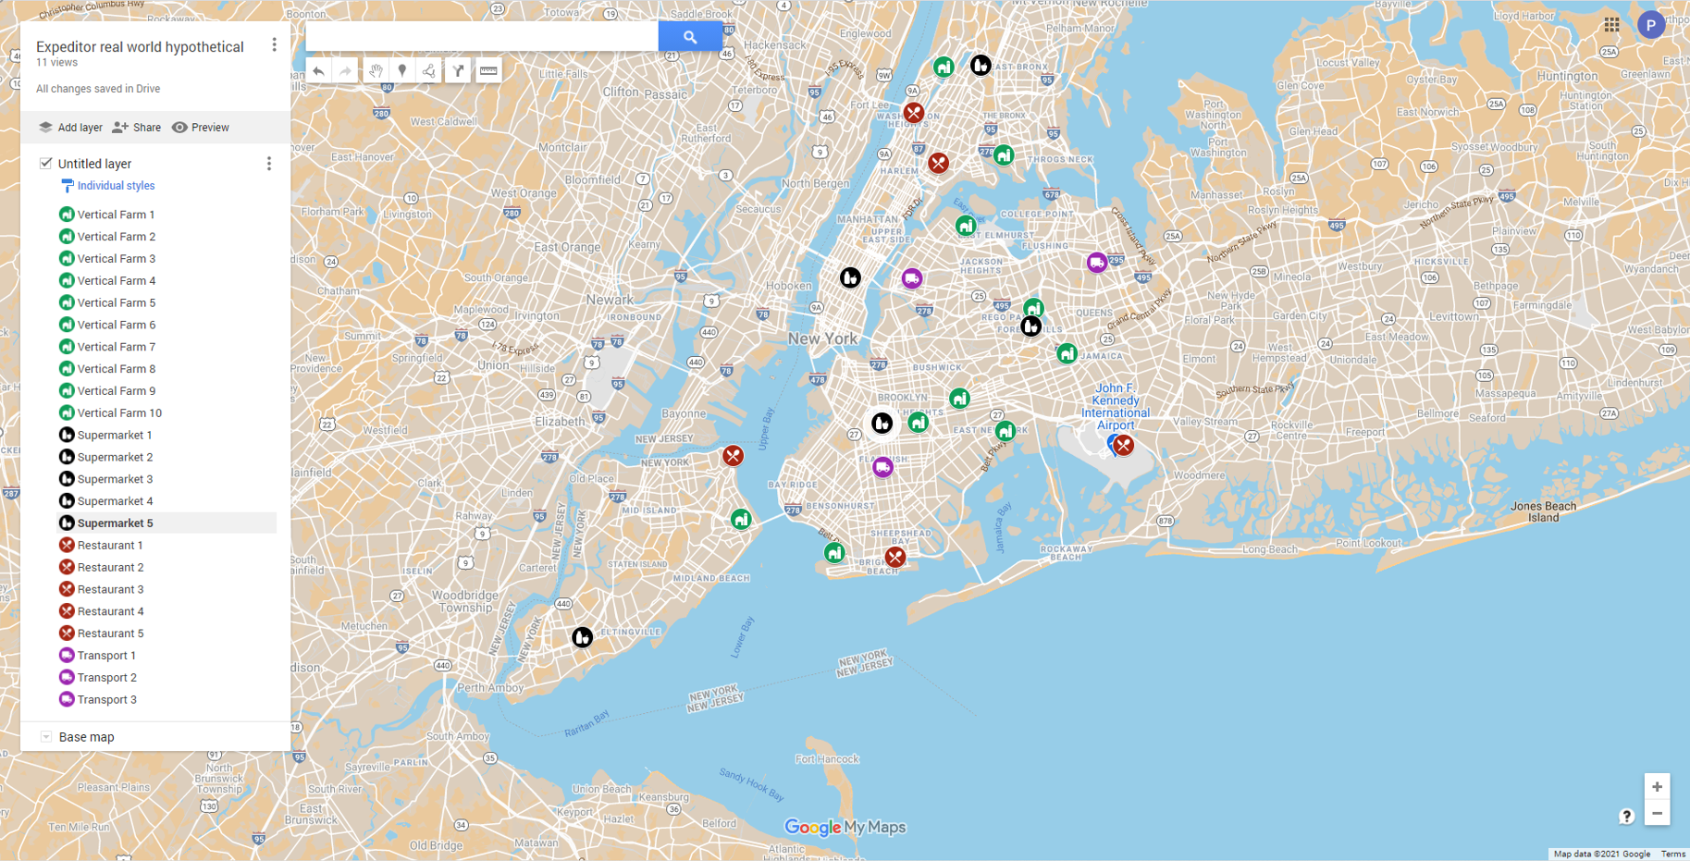
Real world map of Expeditor system

Slide 28
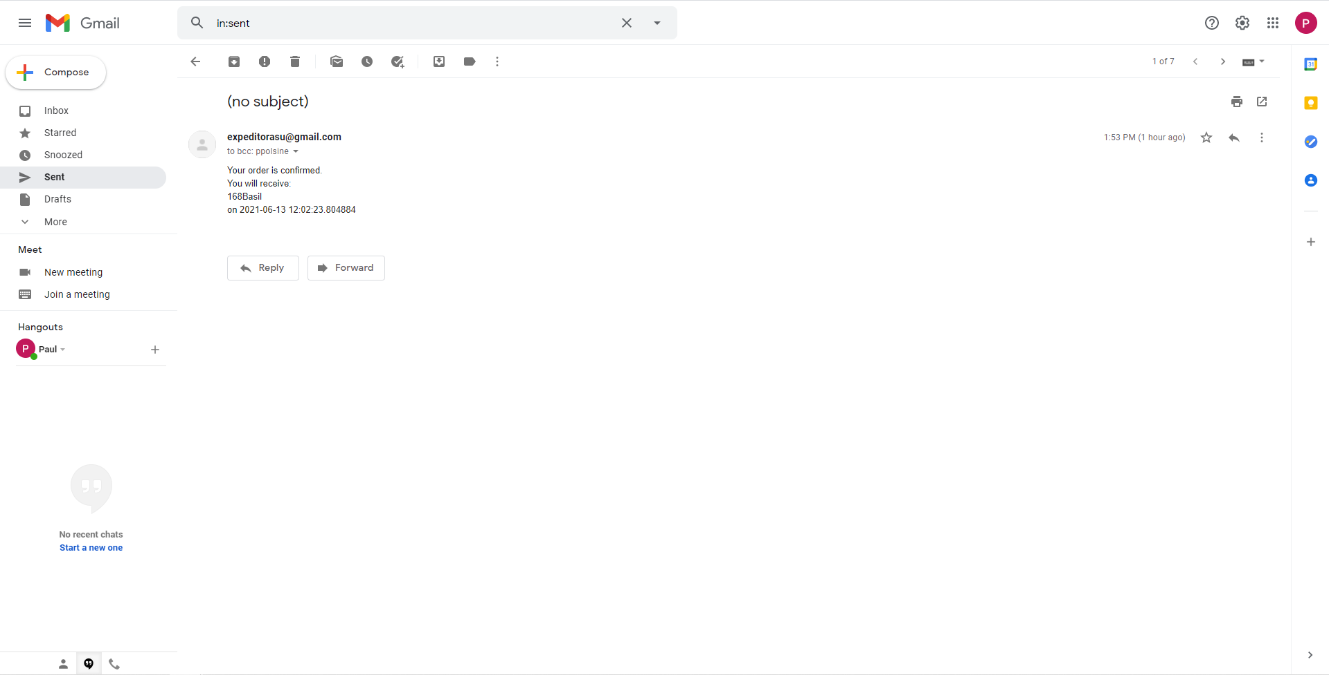
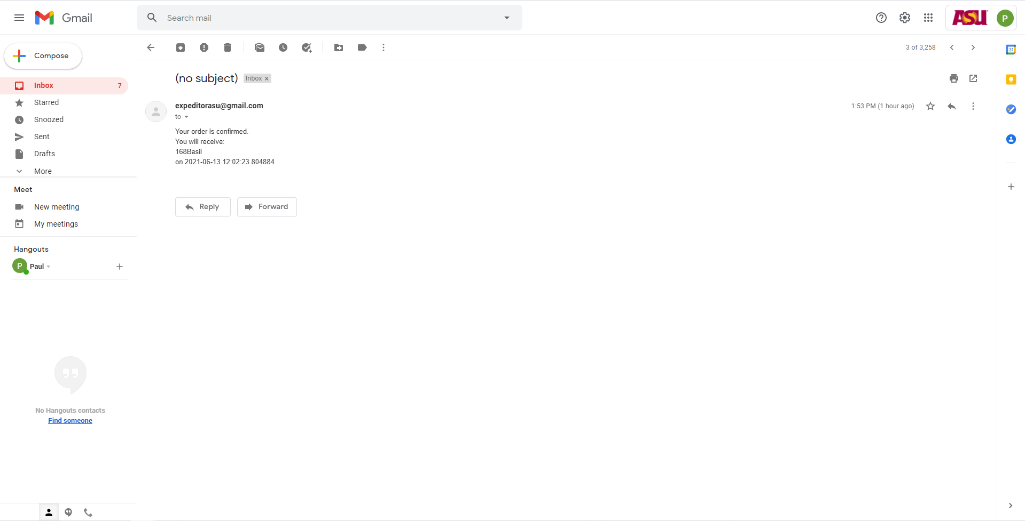
Step 6: email confirmation

Slide 29
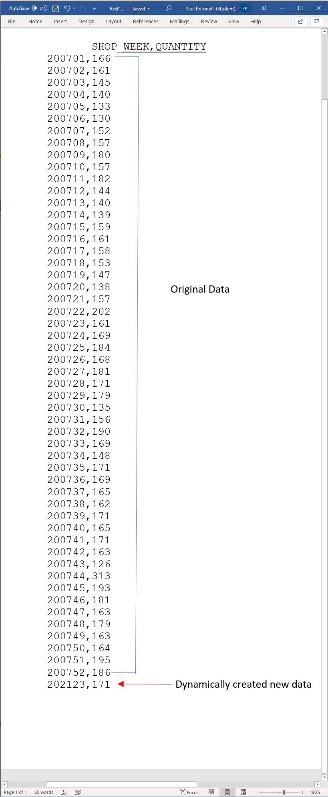
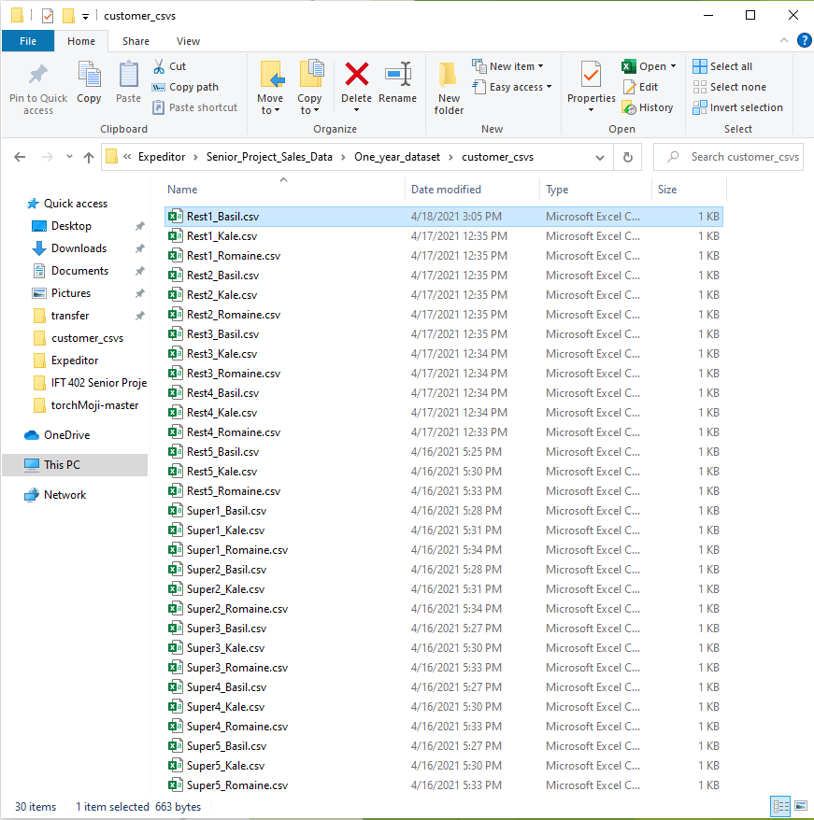
Step 7: update order history csv

Slide 30

Problems

Slide 31
Fixed Issues
This build was much more involved than I had originally thought. I thought I would just add some customer tables and plug them in some how but instead, I wound up having to completely redesign the script to loop over the customer csv files, otherwise it would be unscalable, with about a thousand lines of code added for each new customer. Although it was a tremendous amount of work and research, it was a learning blessing in disguise. I learned coding techniques that are amazingly powerful in their versatility. My scalability problem is no longer. Much of my accomplishment this build is due to learning how to create dynamic variables so the code stays concise and it can handle tremendous amounts of scaling. I also broke the UI again during a migration from Django but learned how to fix it… enough for now. I managed to get all the data I wanted into the UI. Right now, it is very rudimentary, but functional.

Slide 32

Outstanding Issues
The Django query only renders whatever the last table entry is in views.py to the UI. This issue has plagued me the entire project. I have no replies from stackoverflow since I reached out for help 2 months ago. I have no solution at this time.
Amend button not functional due to prioritization of time

Slide 33

What’s next?
The UI needs a lot of work. It needs login capability and a way for Django to scale to more than just one customer
The database needs a ‘Spark’. Because of its increasing scale, for real world functionality, it will need to run on a parallelized Hadoop database platform
The email system needs to aggregate order products so that it doesn’t send a confirmation for every single product, but a whole order instead

